Slide 1
Disjoint Sets
Definition: a set of elements partitioned into a number of disjoint subsets
For example, a partition of the 10 numerals
1, 2, 3, 4, 5, 6, 7, 8, 9, 0
into three disjoint subsets
{1, 2, 3, 5, 7}, {4, 6, 9, 0} , {8}
Also called:
union–find data structure
merge–find set
Notes:
只用作本课程期末复习参考

Slide 2
Operations on Disjoint Sets
There are two operations we would like to perform on disjoint sets:
Determine if two elements are in the same disjoint set, and
Take the union of two disjoint sets creating a single set
We will determine if two objects are in the same disjoint set by defining a find function
find(a): find the representative object of the disjoint set that a belongs to
Given two elements a and b, they are in the same set if
find( a ) == find( b )

Slide 3
Optimization 1
Problem:
The height of the tree may grow very large
To optimize both find and set_union, we must minimize the height of the tree
Therefore, point the root of the shorter tree to the root of the taller tree
The height of the taller will increase if and only if the trees are equal in height

Slide 4
Optimization 2: Path Compression
Another optimization is that, whenever find is called, update the object to point to the root
size_t Disjoint_set::find( size_t n ) {
if ( parent[n] == n ) {
return n;
} else {
parent[n] = find( parent[n] );
return parent[n];
}
}
The next call to find(n) is Θ(1)
The cost is O(h) memory
find(e)
c
c
a
f
h
a
f
h
b
e
b
d
d
i
i
e

Slide 5
Graphs
Undirected/Directed Graphs
Weighted Graphs
Adjacency List
Adjacency Matrix
Other concepts: degree, simple path, ... ...
Graph Traversal: BFS/DFS

Slide 6
Prim’s Algorithm:
we begin with a vertex which represents the root
starting with this trivial tree and iteration, we find the shortest edge which we can add to this already existing tree to expand it
The initialization still requires Θ(|V|) memory and run time
The priority queue will also require Ο(|V|) memory
We iterate |V| – 1 times, each time finding the closest vertex
The size of the priority queue is Ο(|V|)
Pop the closest vertex from the priority queue is O(ln(|V|))
For each of its neighbors, we may update the distance, which is O(ln(|V|)) (“decrease key” can be done with O(ln(|V|)) in a heap).
With an adjacency list, the total run time is O(|V| ln(|V|) + |E| ln(|V|)) = O(|E| ln(|V|))

Slide 7
Cut property
Let S be any subset of nodes, and let e be the least weight edge with exactly one endpoint in S. Then the MST T* contains e.
Proof
Suppose e does not belong to T*.
Adding e to T* creates a cycle C in T*.
e is in a cycle C with exactly one endpoint in S ⇒ there exists another edge f in C with exactly one endpoint in S.
T' = T* ∪ {e} − {f} is also a spanning tree.
Since w_{e} < w_{f}, the weight of T' is smaller than that of T*.
This is a contradiction
f
S
e
T*

Slide 8
Kruskal’s algorithm
Sort the edges by weight
Create a disjoint set of the vertices
Begin adding the edges one-by-one checking to ensure no cycles are introduced
The result is a minimum spanning tree
The run time is Ο(|E| ln(|V|))

Slide 9
Greedy algorithms
Suppose it is possible to build a solution through a sequence of partial solutions
At each step, we focus on one particular partial solution and we attempt to extend that solution
Ultimately, the partial solutions should lead to a feasible solution which is also optimal
Greedy exchange argument
Modify a solution incrementally by any other algorithm into the solution by your greedy algorithm
Justify the modification doesn’t make the solution worsen.
Your solution is at least as good as that of any other solution (optimal solution).

Slide 10
Interval scheduling
Job j starts at s_{j} and finishes at f_{j}.
Two jobs are compatible if they don’t overlap.
Goal: find maximum subset of mutually compatible jobs.
a
b
b
c
d
e
jobs d and g
are incompatible
e
f
g
h
h
time
0
1
2
3
4
5
6
7
8
9
10
11

Slide 11
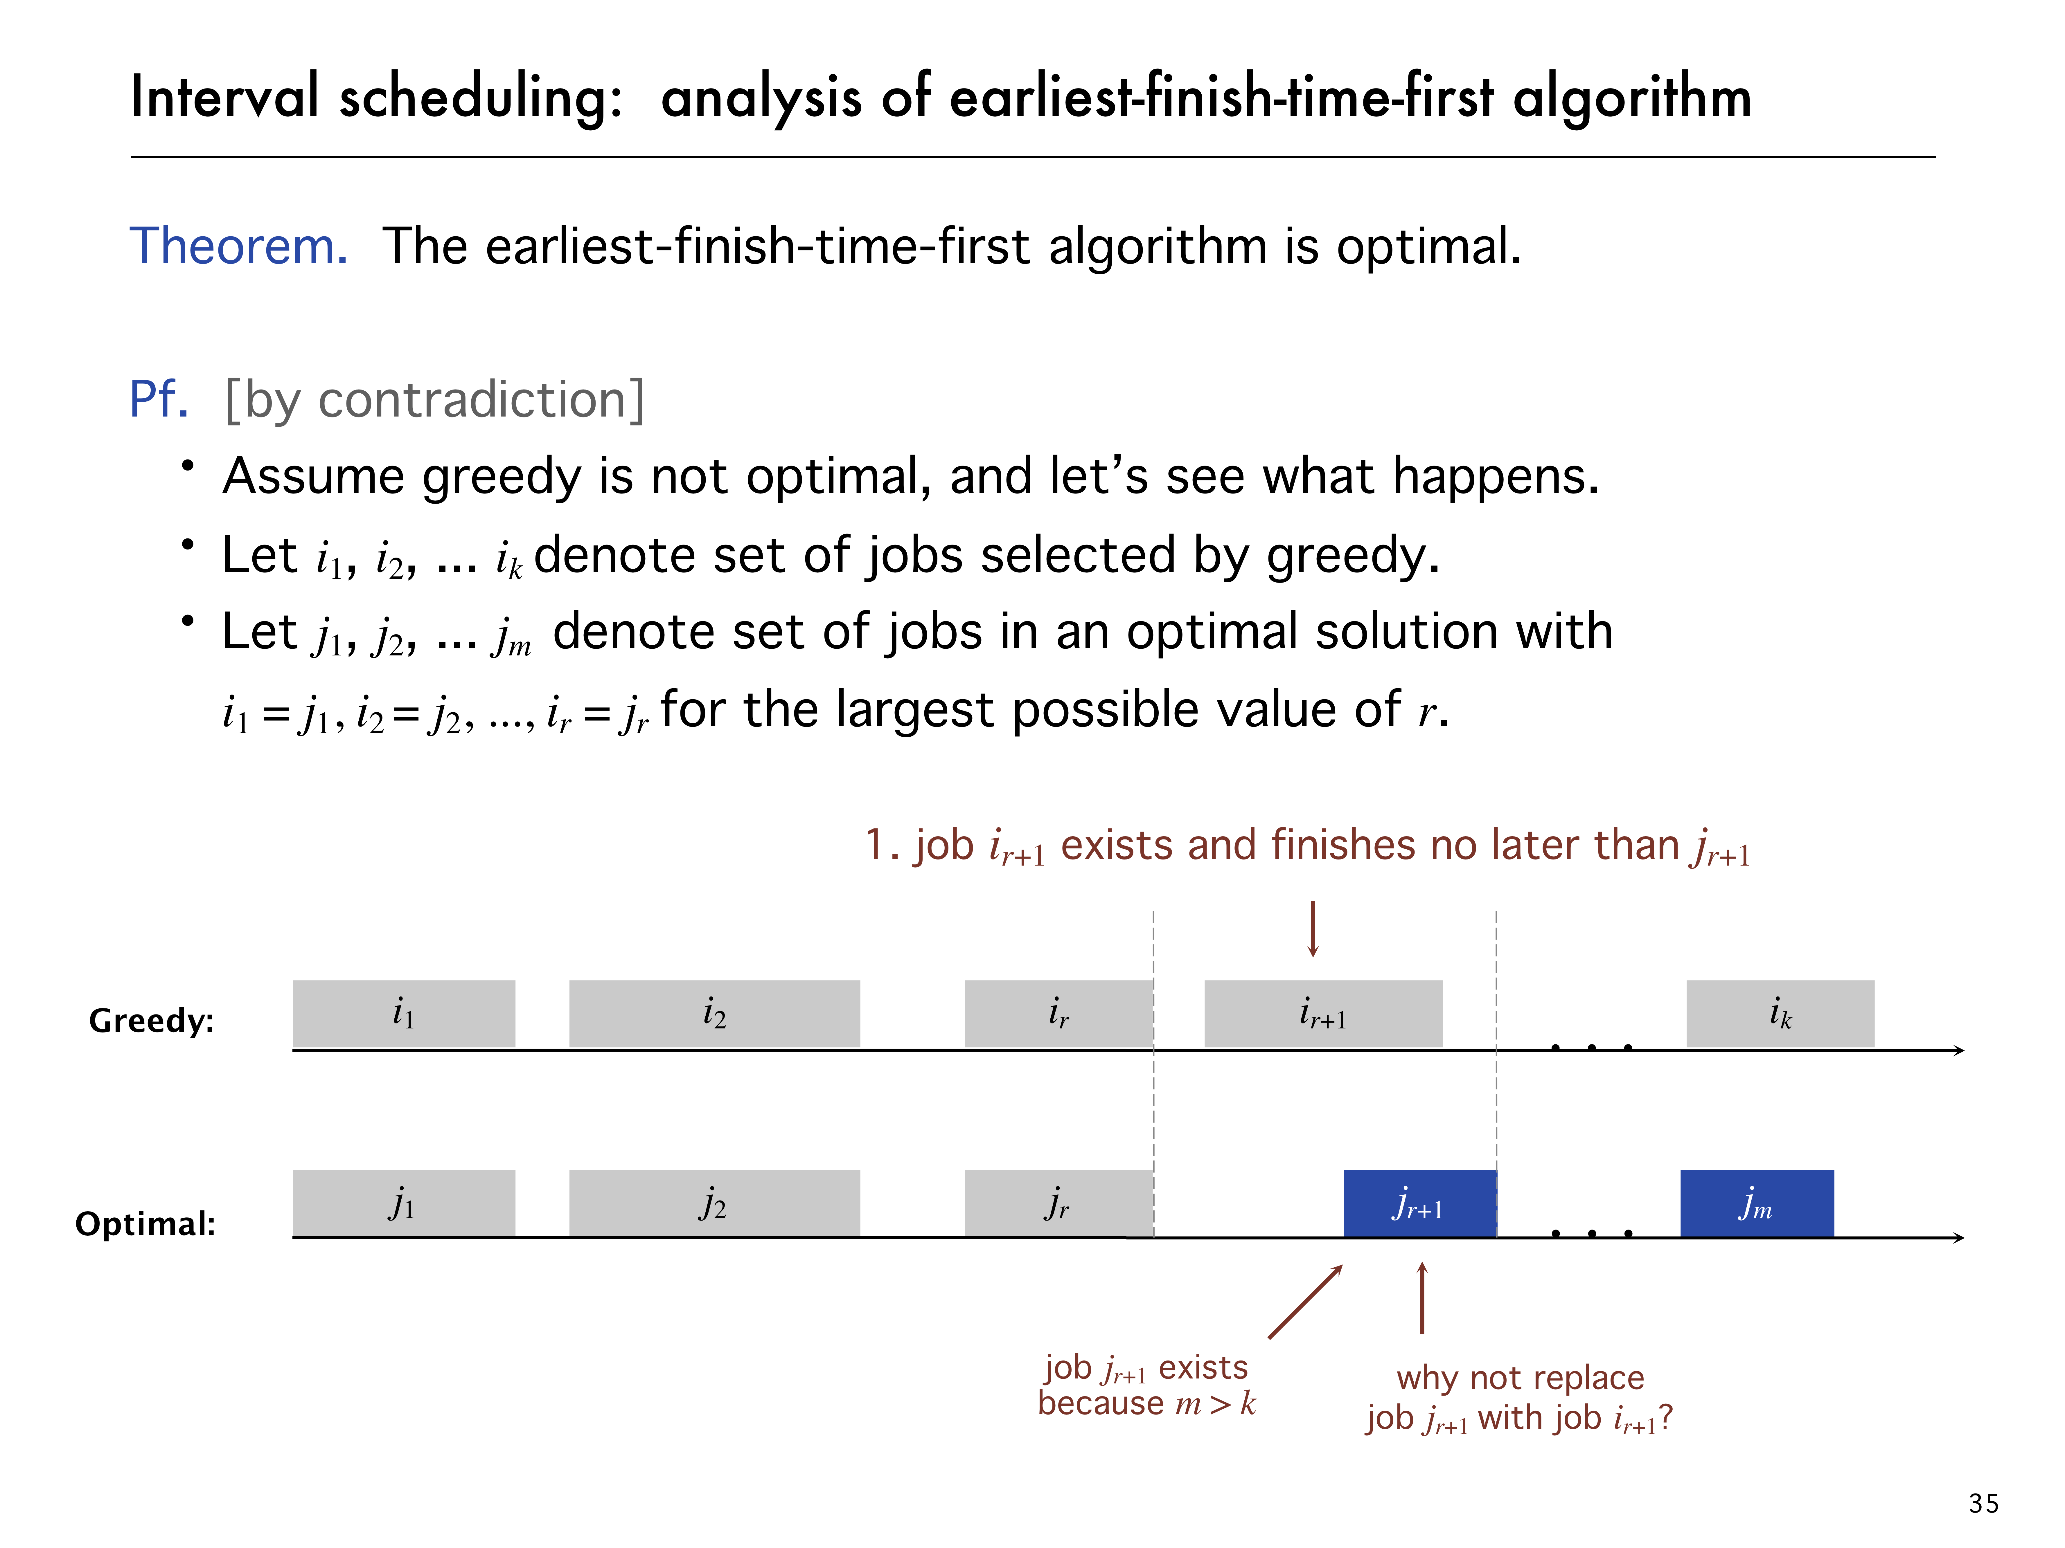

Slide 12
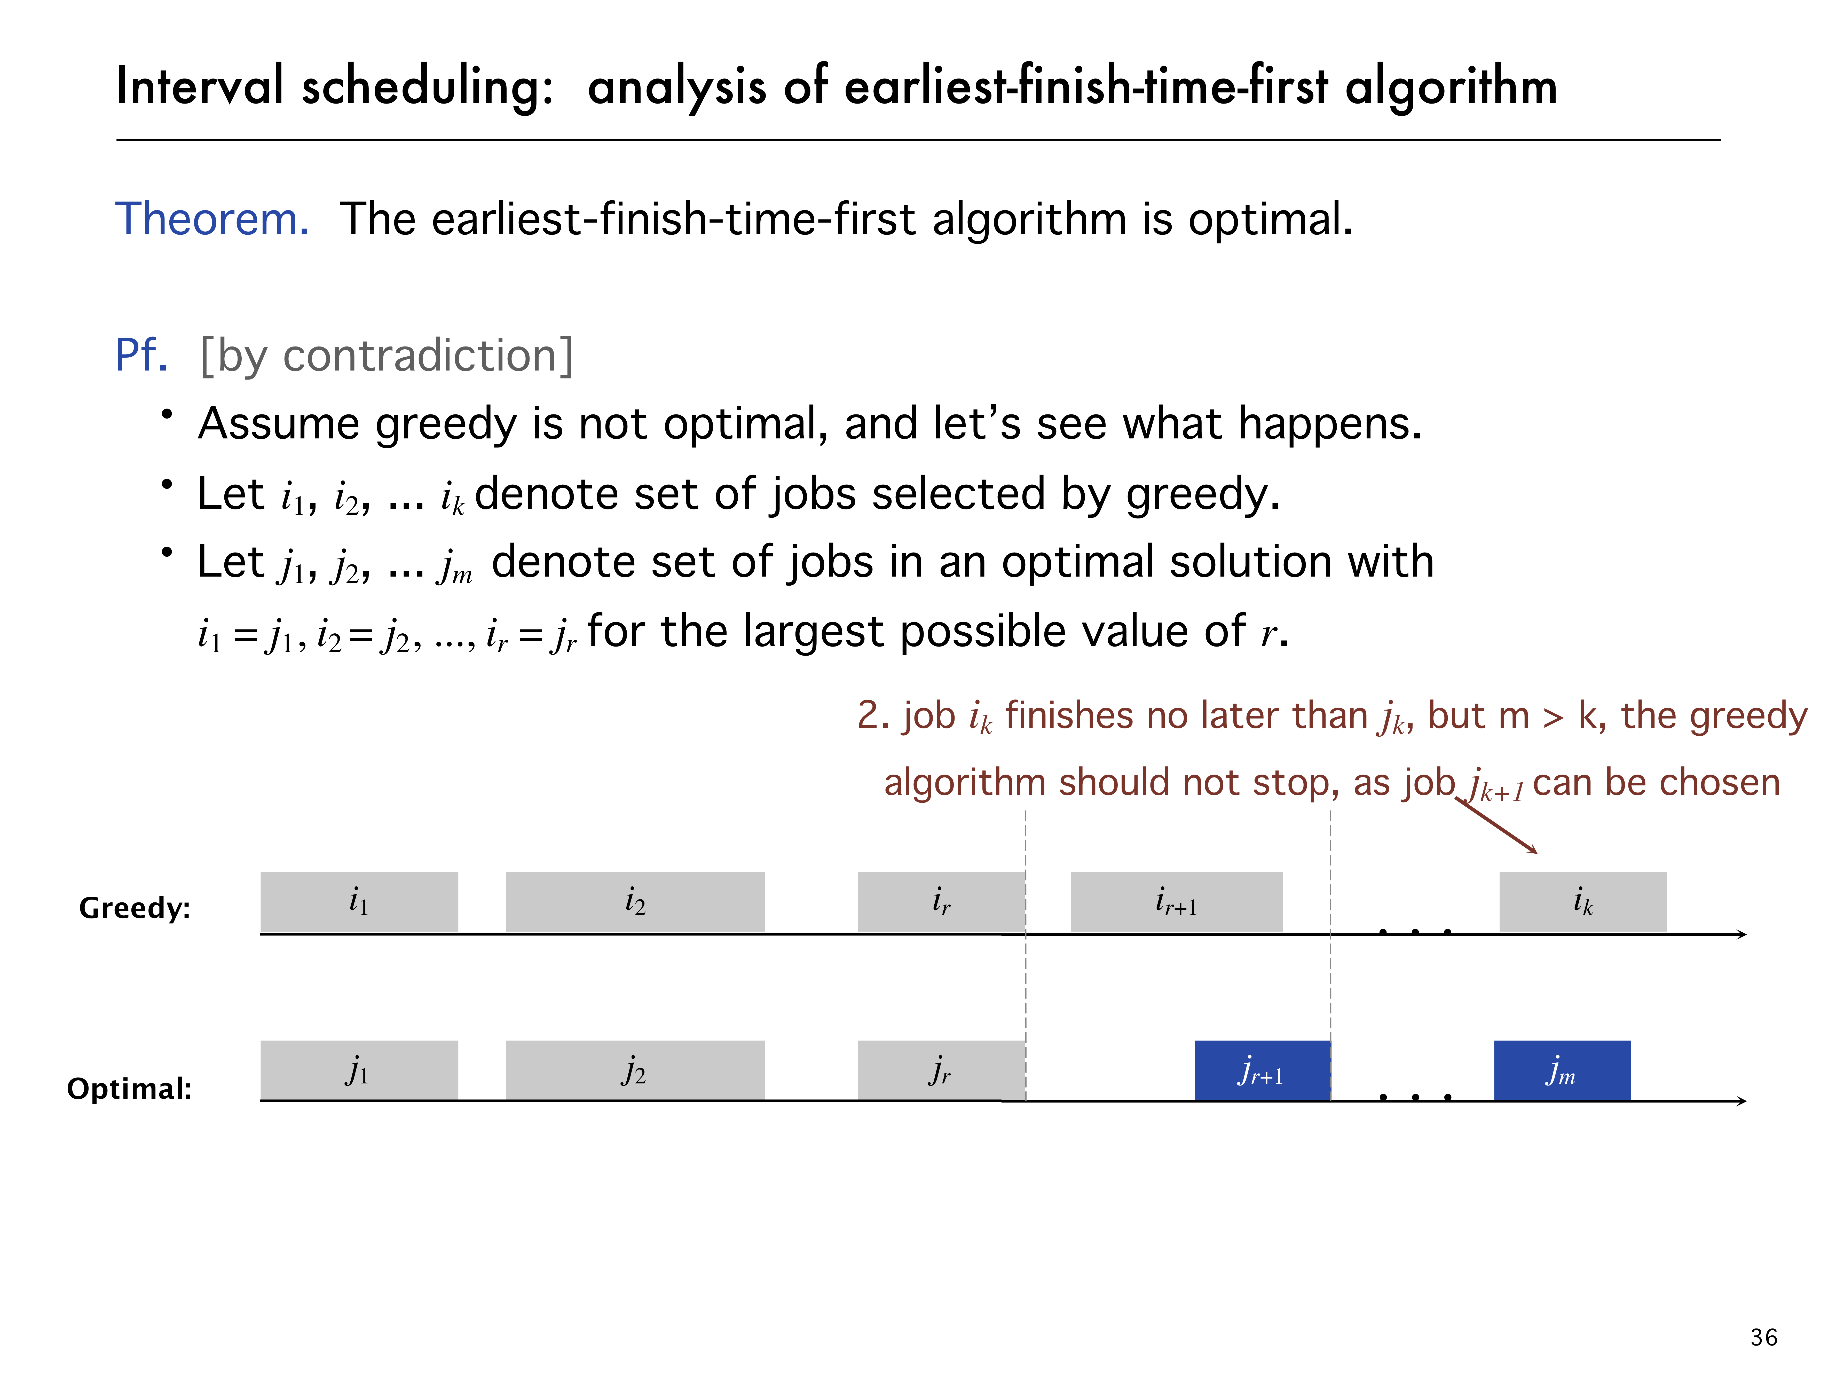

Slide 13
Topological sorting
Given a set of tasks with dependencies, is there an order in which we can complete the tasks?
A topological sorting of the vertices in a DAG is an ordering
v₁, v₂, v₃, …, v_{|V|}
such that v_{j} appears before v_{k} if there is a path from v_{j} to v_{k}

Slide 14
Dijkstra’s algorithm
We will iterate |V| times:
Find the unvisited vertex v that has a minimum distance to it
Mark it as visited
Consider its every adjacent vertex w that is unvisited:
Is the distance to v plus the weight of the edge (v, w) less than our currently known shortest distance to w ?
If so, update the shortest distance to w and record v as the previous pointer
Continue iterating until all vertices are visited or all remaining vertices have a distance of infinity

Slide 15
Implementation and analysis
The initialization still requires Θ(|V|) memory and run time
The priority queue will also requires Ο(|V|) memory
We must use an adjacency list, not an adjacency matrix
We iterate |V| times, each time finding the closest vertex to the source
Place the distances into a priority queue
The size of the priority queue is Ο(|V|)
Thus, the work required for this is O(|V| ln(|V|))
Is this all the work that is necessary?
Recall that each edge visited may result in a distance being updated
Thus, the work required for this is O(|E| ln(|V|))
Thus, the total run time is O(|V| ln(|V|) + |E| ln(|V|)) = O(|E| ln(|V|))

Slide 16
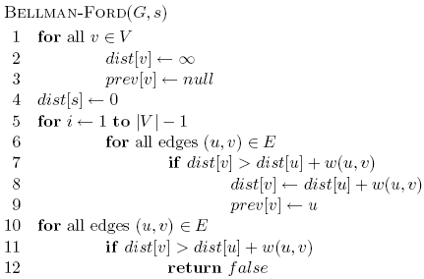
Bellman-Ford algorithm
Loop invariant: After iteration i, all vertices with shortest paths from s of length i edges or less have correct distances
iterate over all edges/vertices and apply update rule
O(|V| |E|)

Slide 17
The Floyd-Warshall Algorithm
It works with positive or negative weights with no negative cycle
Run time
// Initialize the matrix d
// ...
for ( int k = 0; k < num_vertices; ++k ) {
for ( int i = 0; i < num_vertices; ++i ) {
for ( int j = 0; j < num_vertices; ++j ) {
d[i][j] = std::min( d[i][j], d[i][k] + d[k][j] );
}
}
}

Slide 18
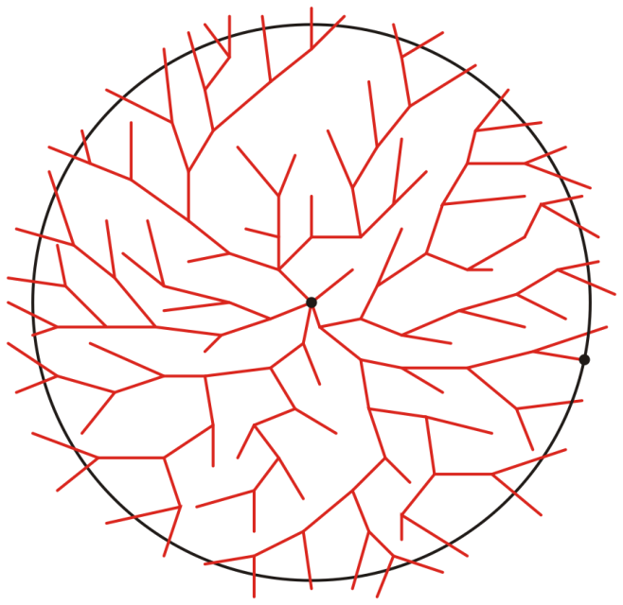
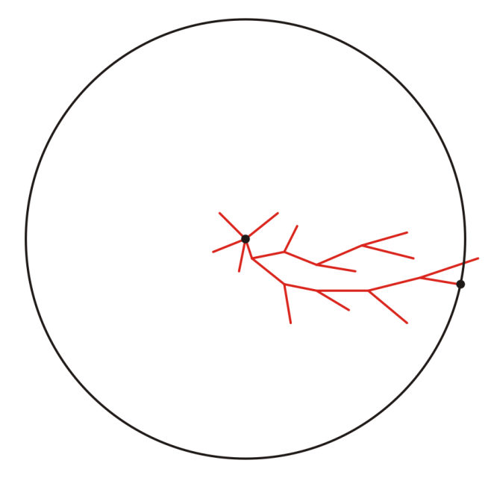
Comparison with Dijkstra’s Algorithm
Dijkstra’s algorithm is the A* search algorithm when the heuristic distance
No vertex is better than any other vertex
a
a
z
z
Representative search patterns for Dijkstra’s and the A* search algorithms

Slide 19
Algorithm Description I (Tree Search)
The algorithm then iterates:
Pop the vertex u with highest priority
For each adjacent vertex (neighbor) v of u:
If w(v) = d(a, u) + d(u, v) + h(v, z) is less than the current weight/priority of v, update the path leading to v and its priority
If v is not in the queue, push v into the queue
Continue iterating until the item popped from the priority queue is the destination vertex z

Slide 20
Algorithm Description II (Graph Search)
The algorithm then iterates:
Pop the vertex u with highest priority
mark u as visited
For each unvisited adjacent vertex (neighbor) v of u:
If w(v) = d(a, u) + d(u, v) + h(v, z) is less than the current weight/priority of v, update the path leading to v and its priority
If v is not in the queue, push v into the queue
Continue iterating until the item popped from the priority queue is the destination vertex z
Note: Tree Search or Graph Search are just two different ways to search the solution.

Slide 21
Admissible Heuristics
Admissible heuristics h must always be optimistic:
Let d(u, v) represent the actual shortest distance from u to v
A heuristic h(u, v) is admissible if h(u, v) ≤ d(u, v)
The heuristic is optimistic or a lower bound on the distance
Using the Euclidean distance between two points on a map is clearly an admissible heuristic
The flight of the crow is shorter than the run of the wolf
A problem with fewer restrictions on the actions is called a relaxed problem
The cost of an optimal solution to a relaxed problem is an admissible heuristic for the original problem
Theorem:
If h(n) is admissible, A* using TREE-SEARCH is optimal.

Slide 22
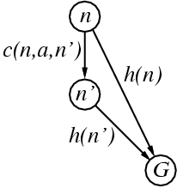
Consistent Heuristics
A heuristic is consistent if for every node n, every successor n' of n generated by any action a, we have
h(n) ≤ c(n,a,n') + h(n')
If h is consistent, we have
w(n’) = d(n’) + h(n’) (by def.)
= d(n) + c(n,a,n') + h(n’) (d(n’)=d(n)+c(n.a.n’))
≥ d(n) + h(n) = w(n) (consistency)
w(n’) ≥ w(n)
i.e., w(n) is non-decreasing along any path.
Theorem:
If h(n) is consistent, A* using GRAPH-SEARCH is optimal.
It’s the triangle
inequality !
keeps all checked nodes
in memory to avoid repeated states

Slide 23
Greedy. Process the input in some order, myopically making irrevocable decisions.
Divide-and-conquer. Break up a problem into independent subproblems; solve each subproblem; combine solutions to subproblems to form solution to original problem.
Dynamic programming. Break up a problem into a series of overlapping subproblems; combine solutions to smaller subproblems to form solution to large subproblem.
fancy name for
caching intermediate results
in a table for later reuse

Slide 24

Observation. Recursive algorithm is spectacularly slow because of overlapping subproblems ⇒ exponential-time algorithm.
Ex. Number of recursive calls for family of “layered” instances grows like Fibonacci sequence.
5
1
1
4
3
2
2
3
3
3
2
2
1
4
4
2
1
1
0
1
0
5
5
p(1) = 0, p(j) = j-2
1
0
recursion tree

Slide 25




House coloring problem
Goal. Paint a row of n houses red, green, or blue so that
No two adjacent houses have the same color.
Minimize total cost, where cost(i, color) is cost to paint i given color.
 | A | B | C | D | E | F
 | 7 | 6 | 7 | 8 | 9 | 20
 | 3 | 8 | 9 | 22 | 12 | 8
 | 16 | 10 | 4 | 2 | 5 | 7
cost to paint house i the given color

Slide 26
House coloring problem
Subproblems.
R[i] = min cost to paint houses 1, …, i with i red.
G[i] = min cost to paint houses 1, …, i with i green.
B[i] = min cost to paint houses 1, …, i with i blue.
Optimal cost = min { R[n], G[n], B[n] }.
Dynamic programming equation.
R[i + 1] = cost(i+1, red) + min { B[i], G[i] }
G[i + 1] = cost(i+1, green) + min { R[i], B[i] }
B[i + 1] = cost(i+1, blue) + min { R[i], G[i] }
Running time. O(n).
overlapping
subproblems

Slide 27
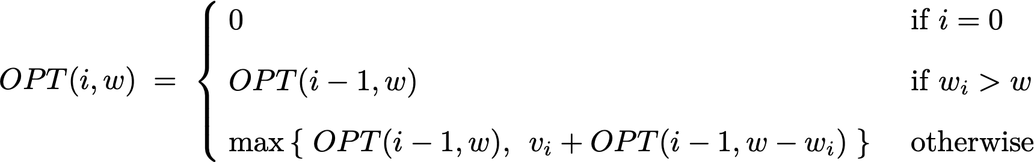
Dynamic programming: adding a new variable
Def. OPT(i, w) = max-profit subset of items 1, …, i with weight limit w.
Goal. OPT(n, W).
Case 1. OPT(i, w) does not select item i.
OPT(i, w) selects best of { 1, 2, …, i – 1 } using weight limit w.
Case 2. OPT(i, w) selects item i.
Collect value vi.
New weight limit = w – wi.
OPT(i, w) selects best of { 1, 2, …, i – 1 } using this new weight limit.
Bellman equation.
possibly because wi > w
optimal substructure property
(proof via exchange argument)

Slide 28
Reduction
Suppose that X ≤ _{P} Y. Which of the following can we infer?
If X can be solved in polynomial time, then so can Y.
X can be solved in poly time iff Y can be solved in poly time.
If X cannot be solved in polynomial time, then neither can Y.
If Y cannot be solved in polynomial time, then neither can X.

Slide 29
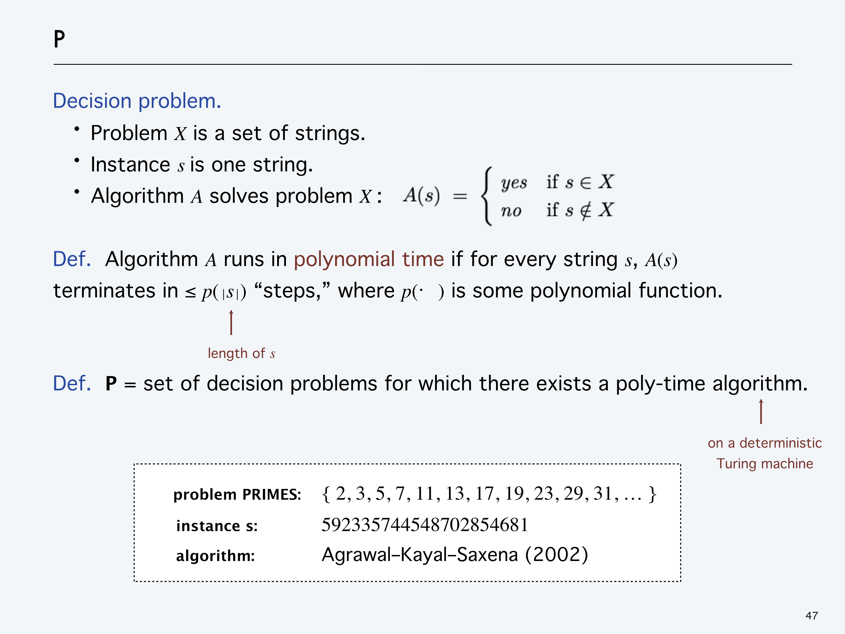

Slide 30
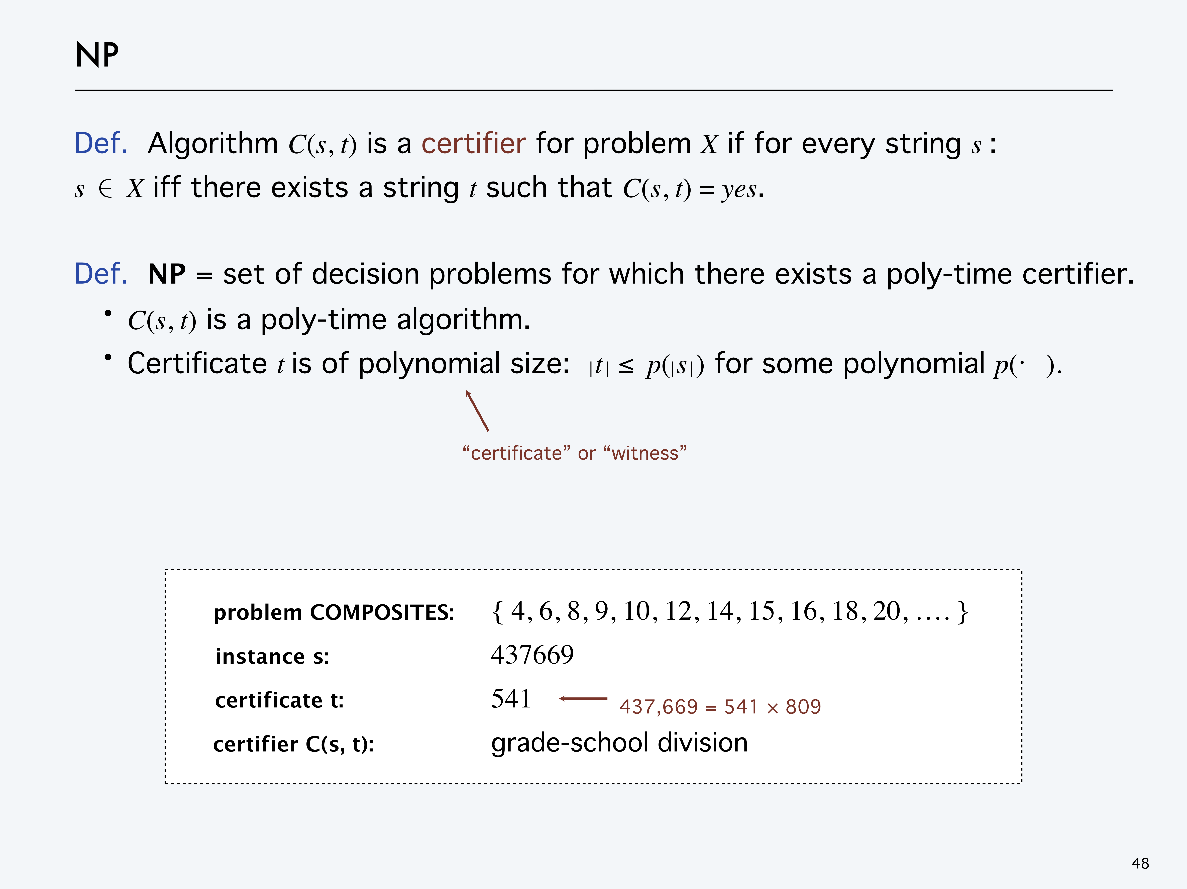

Slide 31
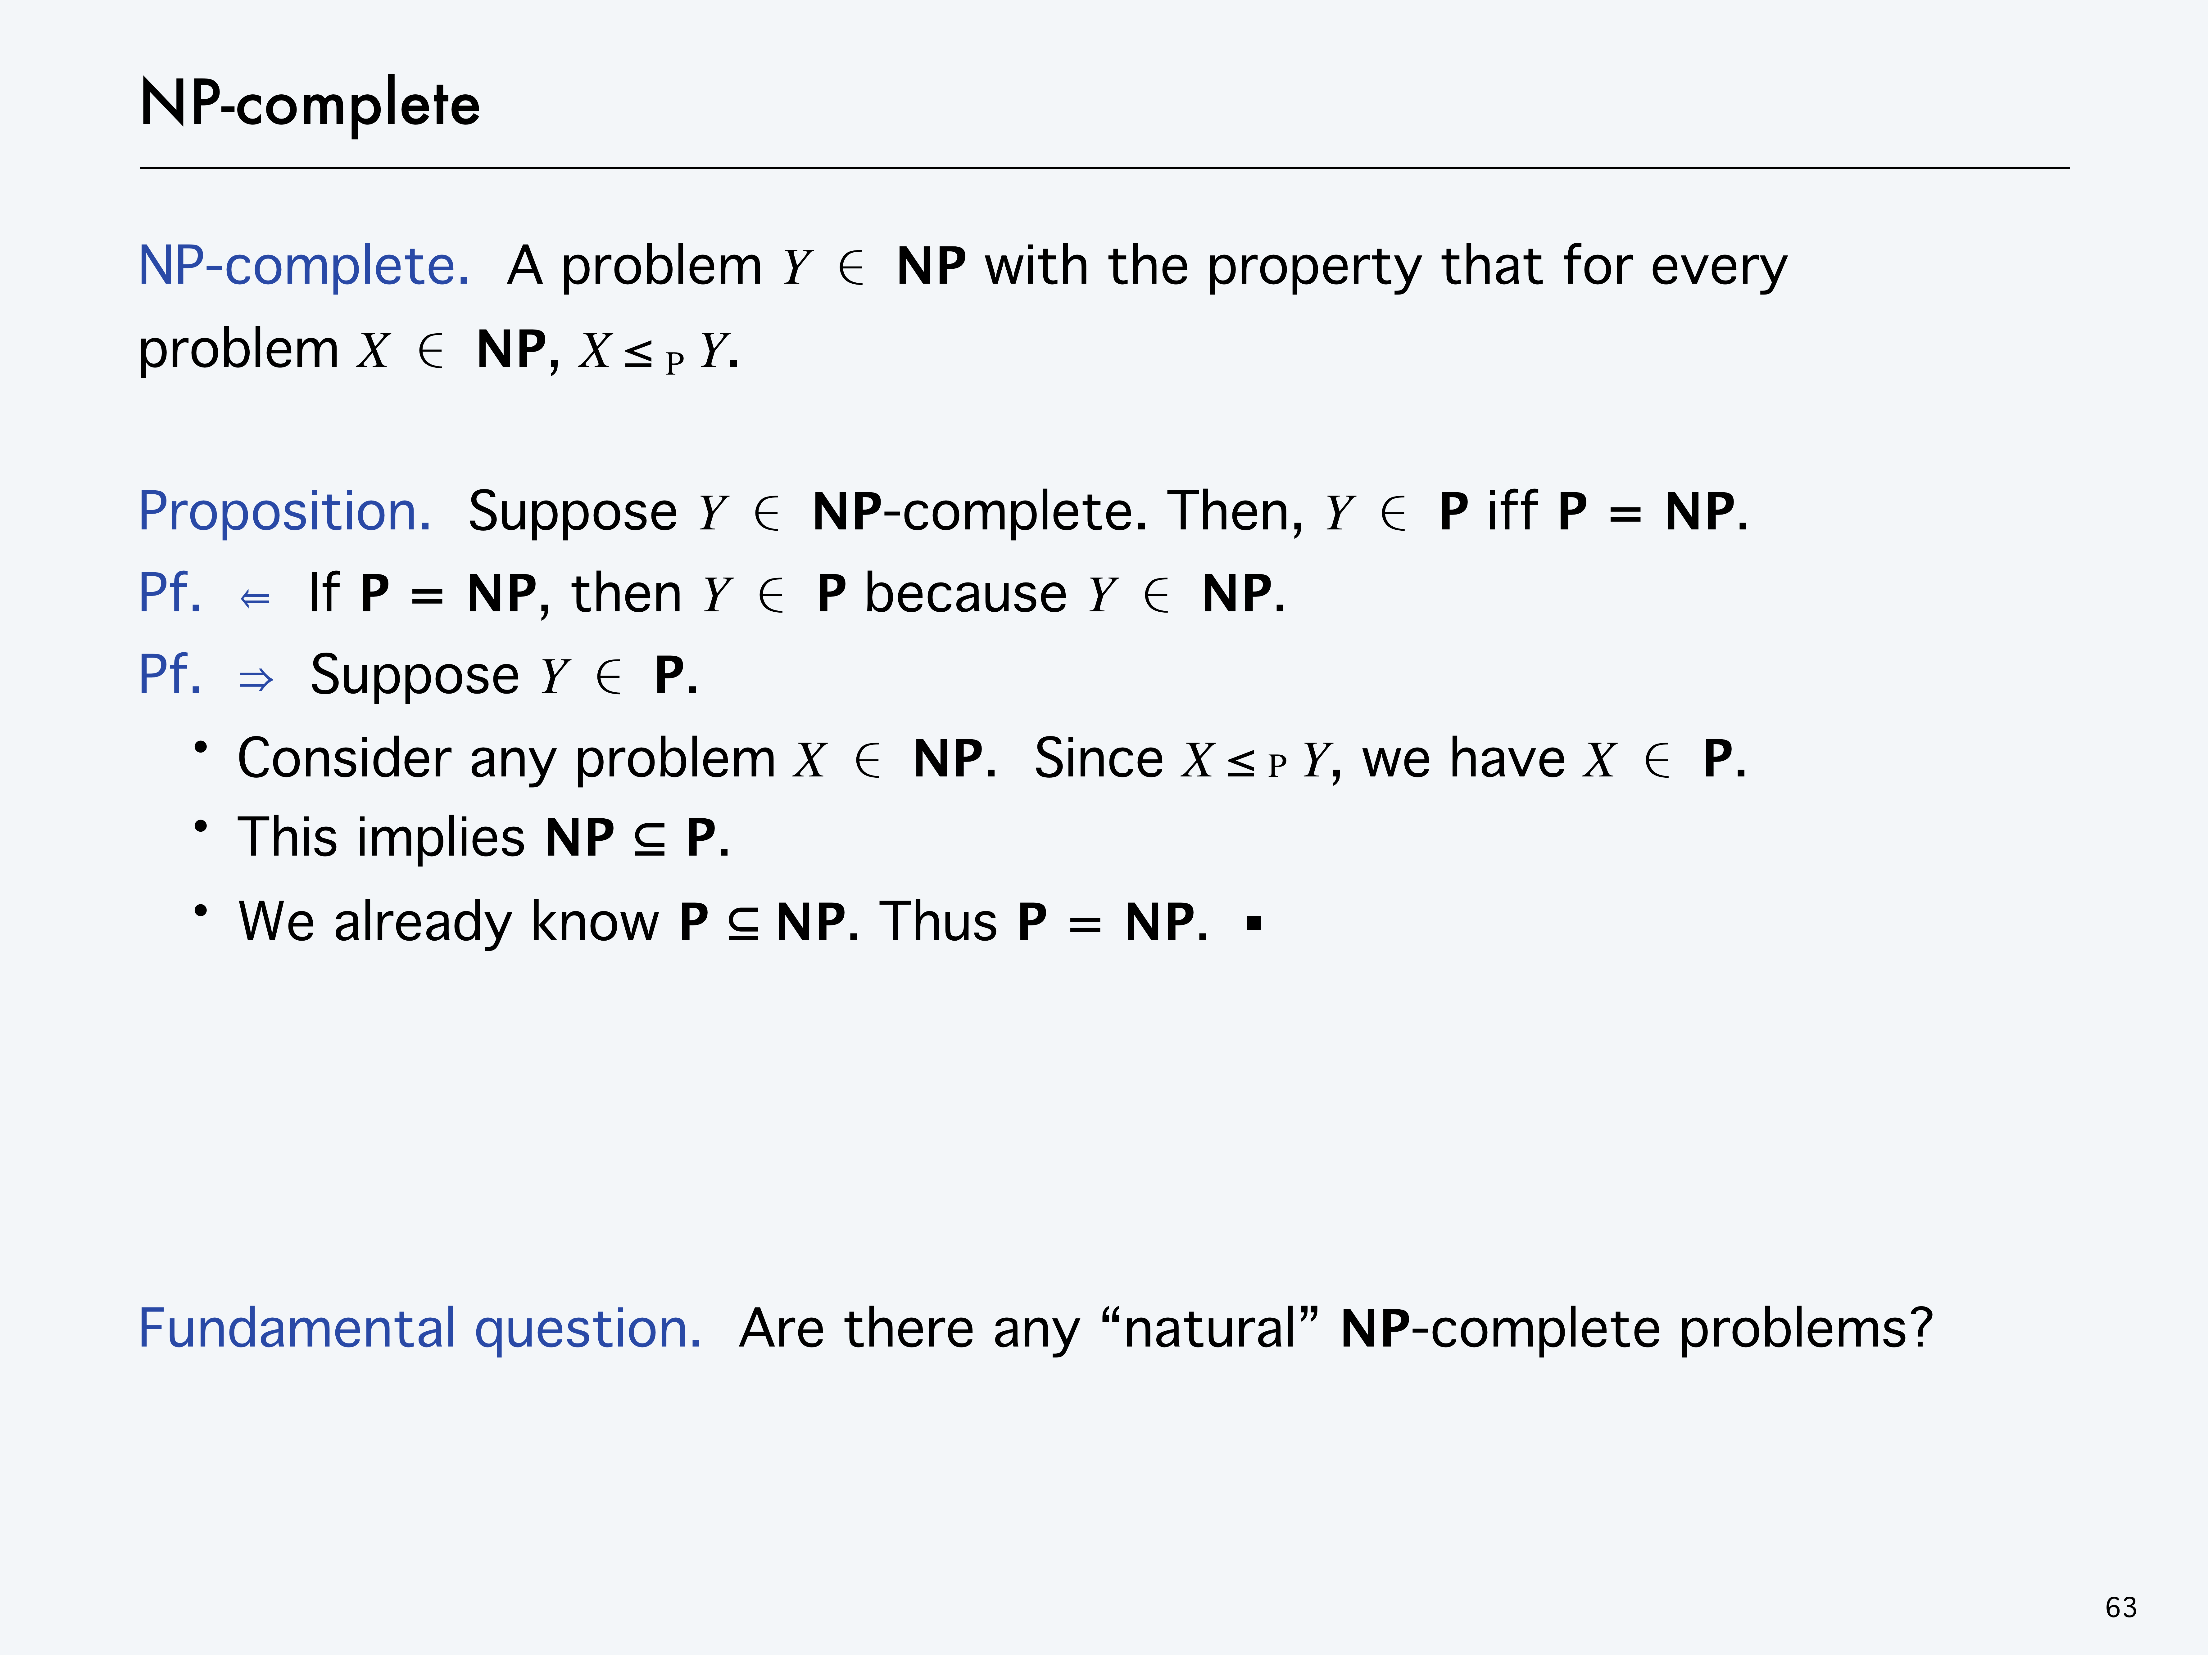

Slide 32
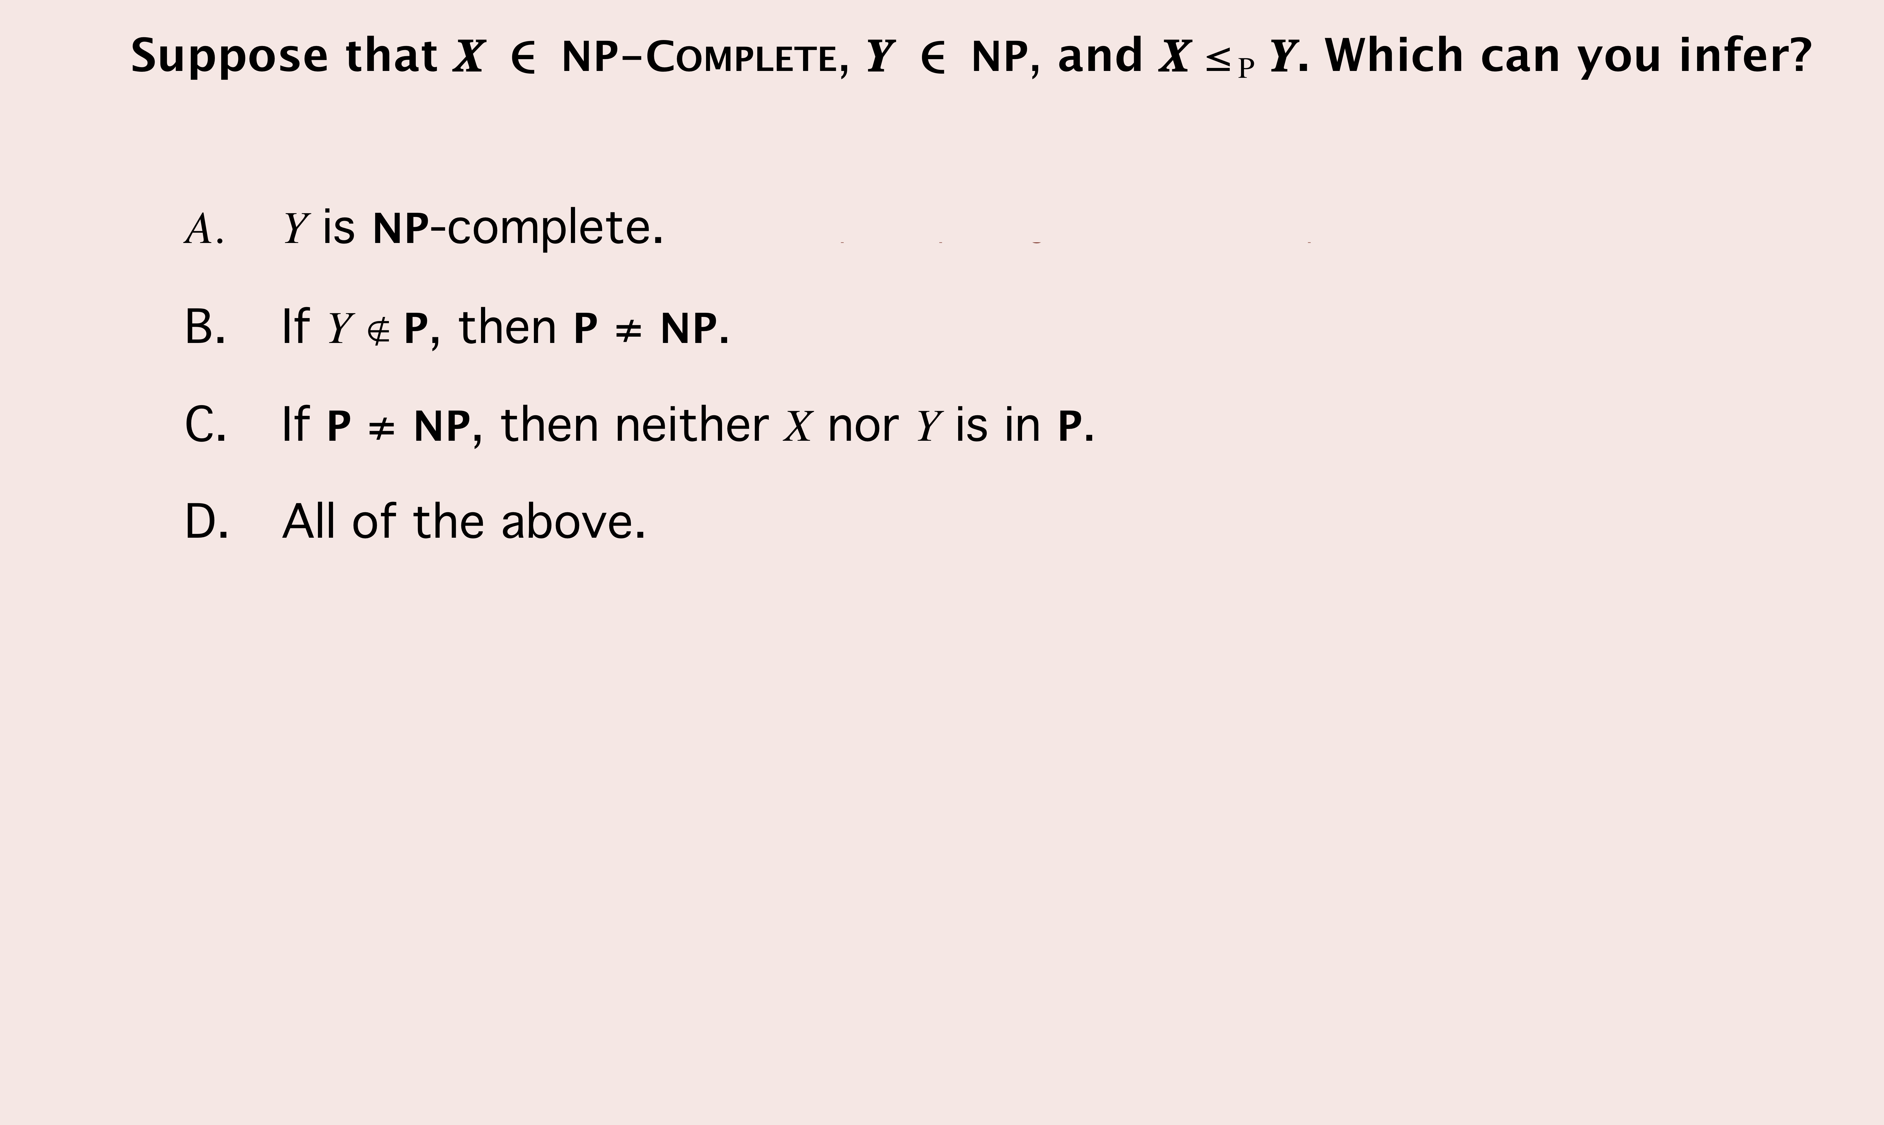
Reduction，P, NP, NPC

Slide 33
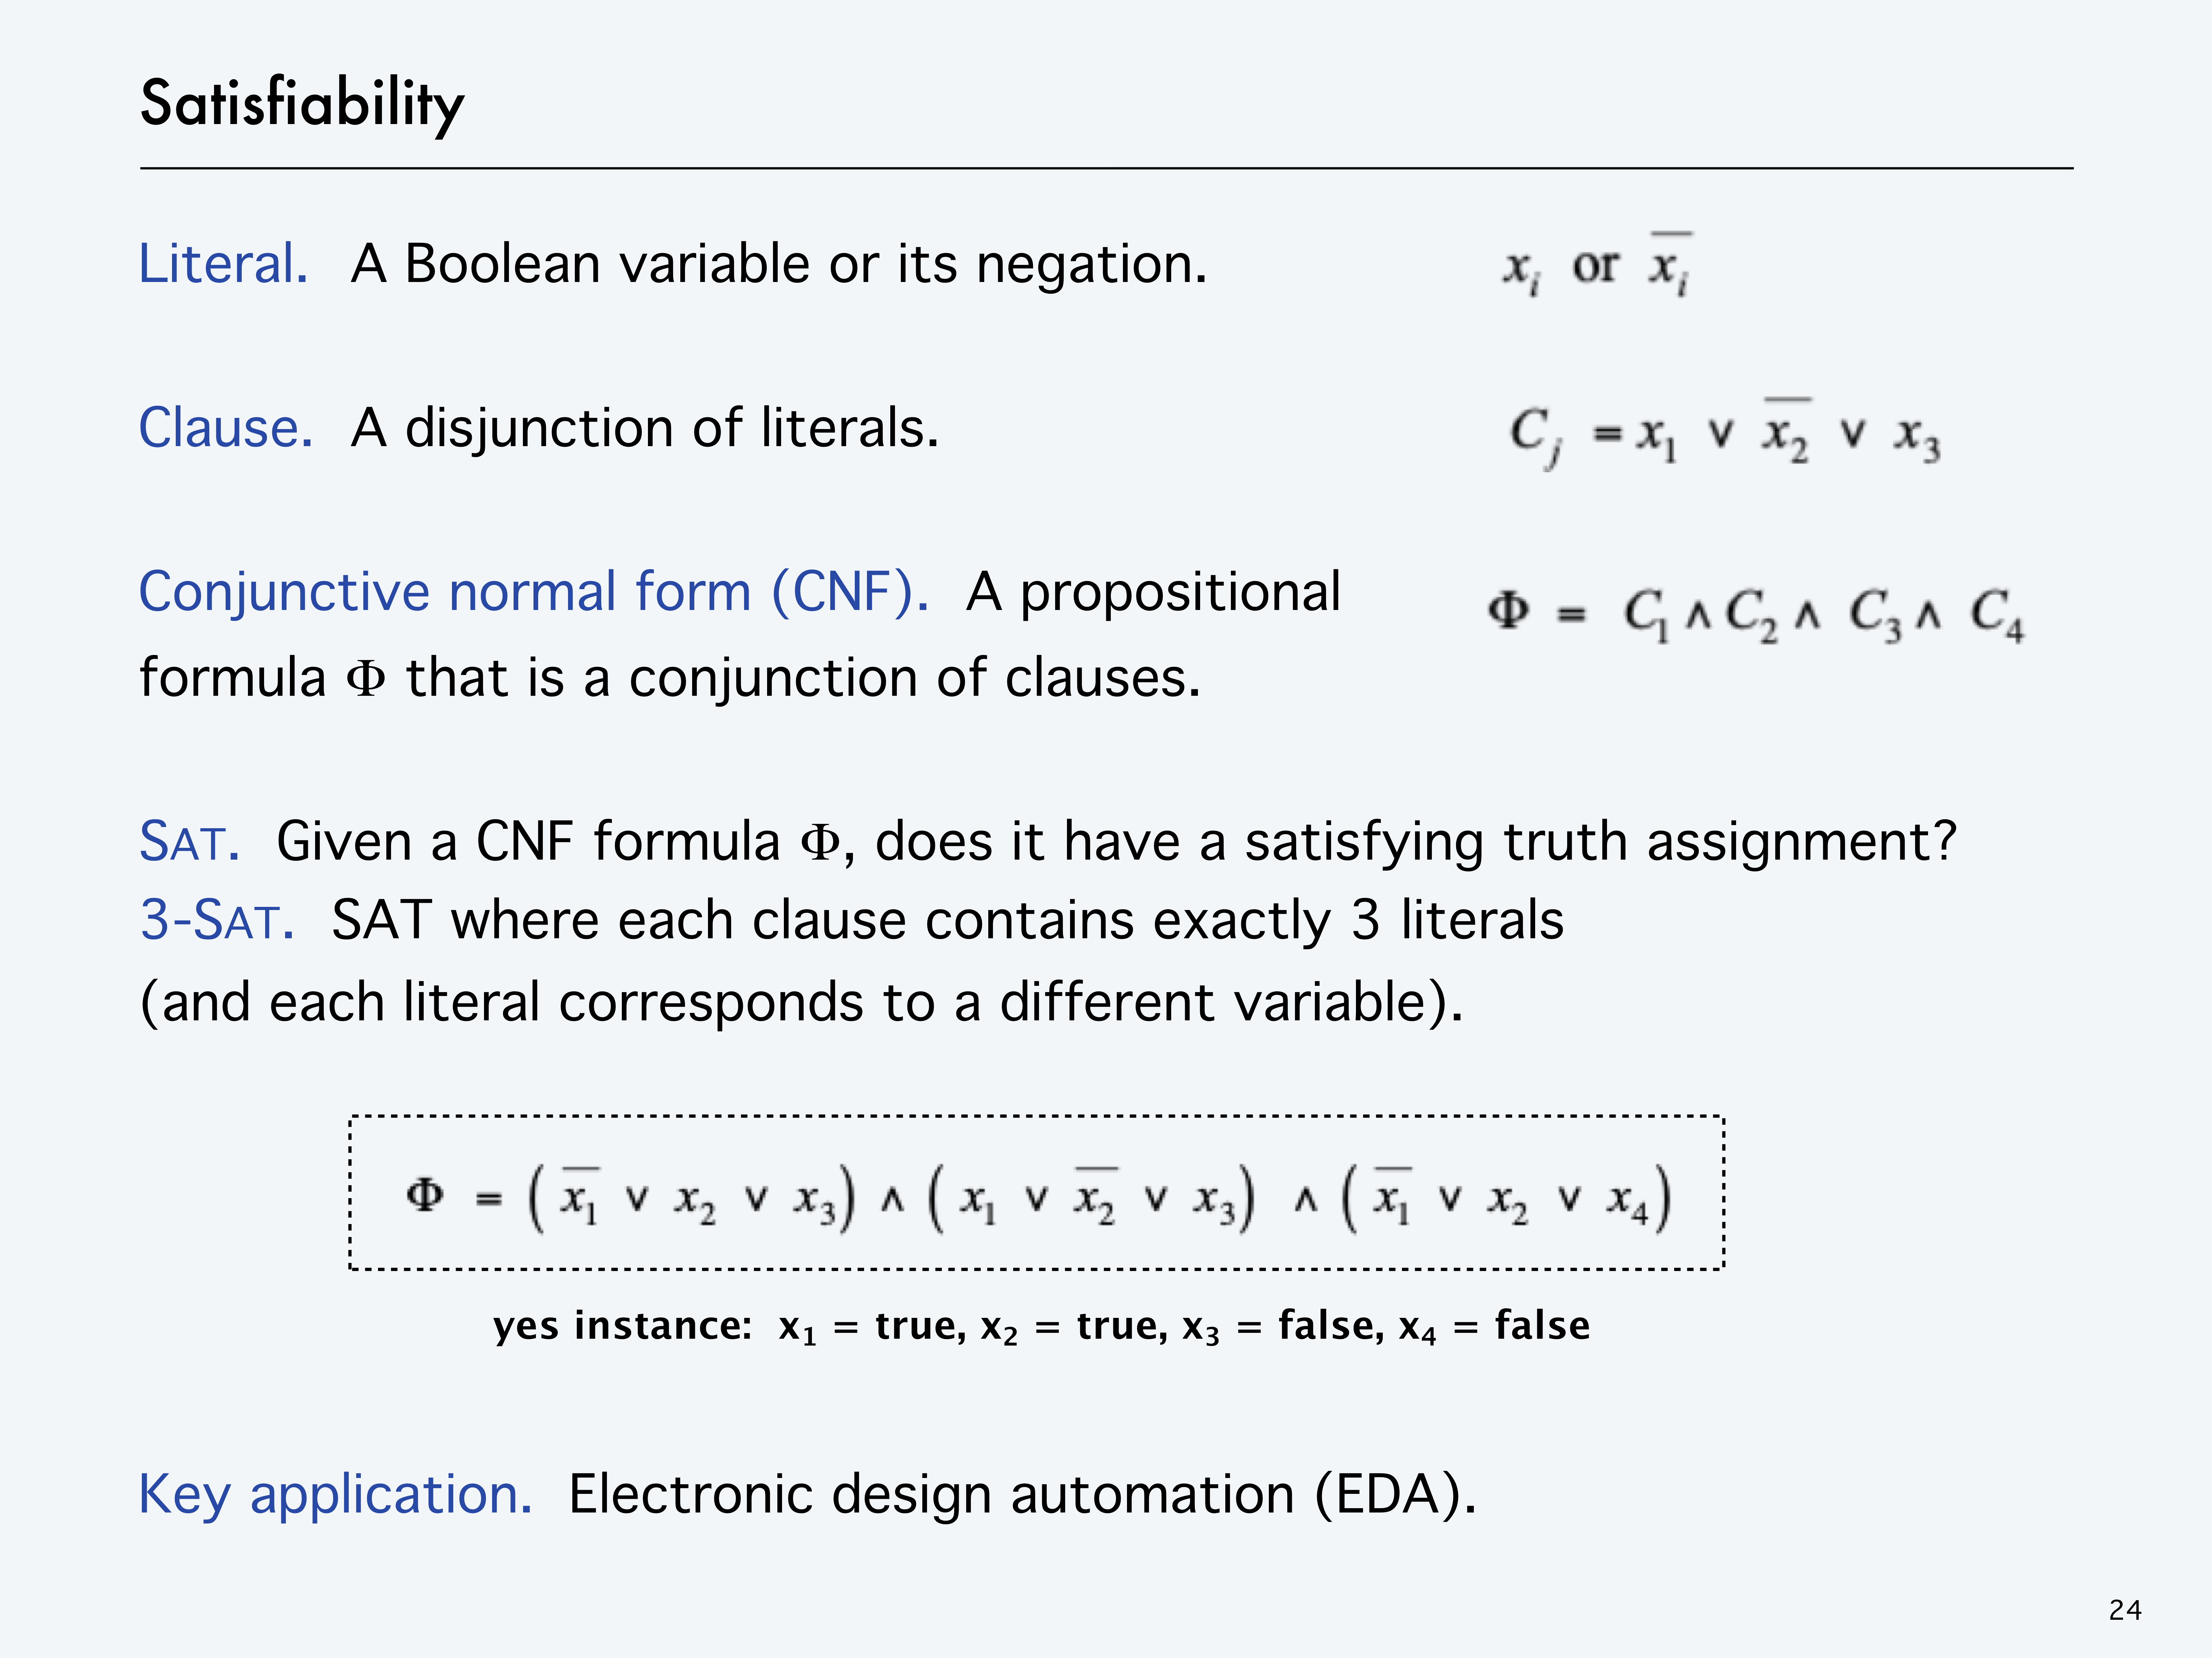

Slide 34
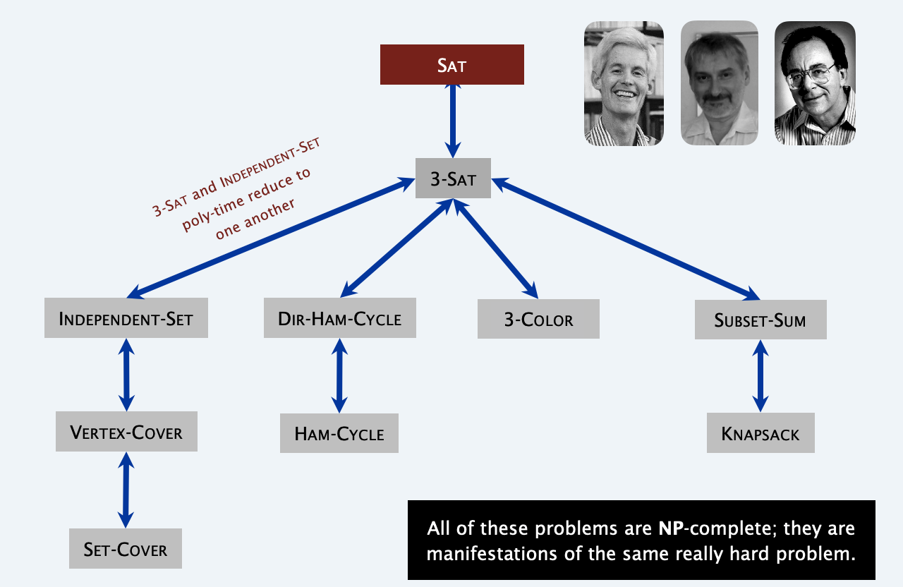
P 、 NP 、 NPC and NPC Proof
Reduction (Karp、Cook)
3SAT、Independent Set、Vertex Cover、Set Cover … …
EXP
P = NP
If P = NP
EXP
NP
P
If P ≠ NP

